Slide 1


Creating Safe Environments that Inspire Innovation
Cynthia Taylor
Sr. Manager, Software Engineering and QA

Slide 2

THE JOURNEY
July, 2013
6 months & .5 Million Dollars
September 2014
Minutes & 10s of Dollars
Deciding to start was big
Finishing was bigger
The accomplishment was astounding

Slide 3

WHAT MAKES AN ENVIRONMENT SAFE?
Trust, in each other and our leaders
Teamwork
Support for new ideas and new techniques
The ability to fail, and recover

Slide 4
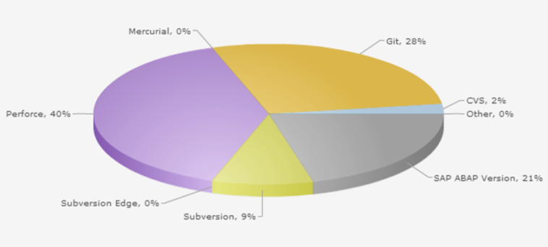
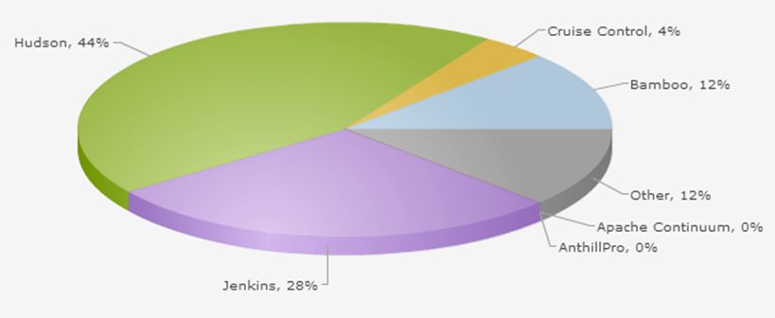
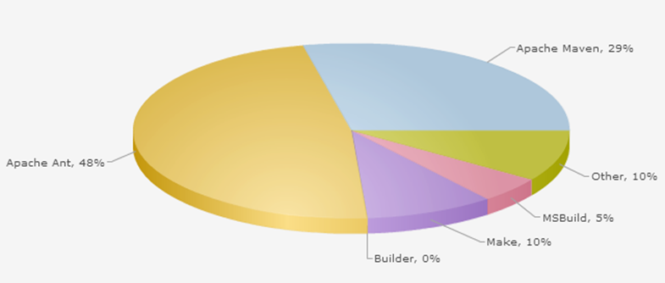
OUR BEFORE PICTURE
A dozen different development and QA teams
Myriads of tools and processes
Over 500 technologies, applications, and systems
QA deployments that took days and derailed dev effort
Little accounting of unplanned work
Much application knowledge that existed in people’s heads

Slide 5
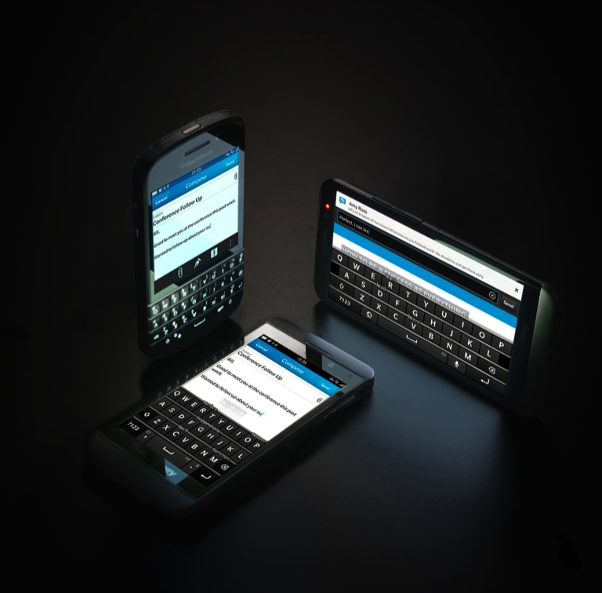
HOW WE TACKLED IT
It started with a new vision, and a new organization
It continued with new roles for our leaders, and support for new thoughts
But it succeeded because passionate, driven people made it happen

Slide 6
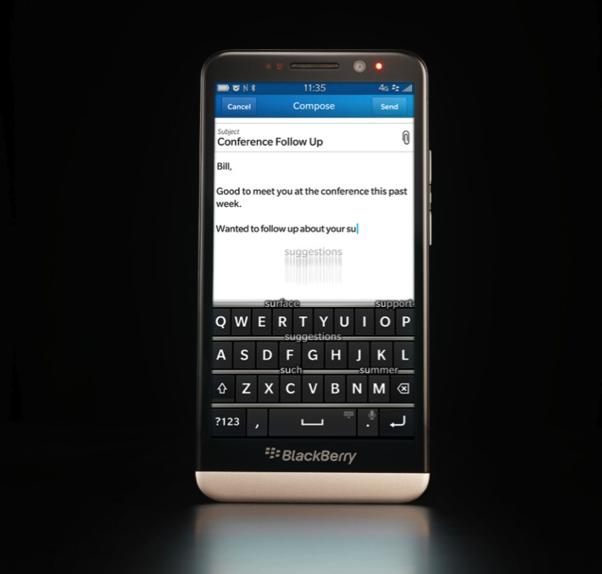
NEW VISION, NEW ORG
“Get The Right Stuff Done”
Agile adoption
Move to a Matrix Organization
Bringing the operations team under the same organizational structure
Formation of the “Practices”

Slide 7

“CHANGE THE WORLD”
Recognition that what we had wasn’t going to move us forward
Formed a team of people who volunteered 20% of their time
Initial Scope:
Common Tools
Policies and Practices
Knowledge Sharing and Building Technical SMEs
Automation
Ultimately, all the effort merged into our CTW Framework

Slide 8







Code change by a developer locally
Upload to Source Control (GitLabs)
Continuous Build Triggered on Checkin.
Jenkins / Maven / Sonar analysis and report
On successful build, Deploy app
Smoke Test via Selenium or SOAP UI
Jenkins Triggers Rundeck, which orchestrates Chef recipe and brings up Infrastructure

Slide 9

CRITICAL SUCCESS FACTORS
Finding people who believed it could be done
Starting with a non-production test application
Interest but no interference from management
Private Cloud availability
Public celebrations of the wins

Slide 10
CHALLENGES
Buy In
Passive Resistance
Time
Support from other departments
Morale

Slide 11
SIGNS OF SUCCESS
“Can you please replace me with a small shell script?”
Noticing the fires that aren’t burning
Non-believers become believers

Slide 12
TAKEAWAYS
Support At All Levels
VP
Leader
Team Members
Find your believers
Give them time, space, and support
Celebrate the wins
Evolution, not Revolution

Slide 13
HERE’S WHAT I NEED HELP WITH
How do you combat ebbs and flows of engagement to inspire continuous excitement?

Slide 14
THANK YOU

